Slide 1
Introduction to Software Engineering
Requirements Modeling – Data Flow & Behavior (2)
Muhammad Nasir
m.nasir@iiu.edu.pk

Slide 2
Agenda
Creating Behavioral Model
Identifying event in Use cases
State Diagram
Sequence Diagram

Slide 3
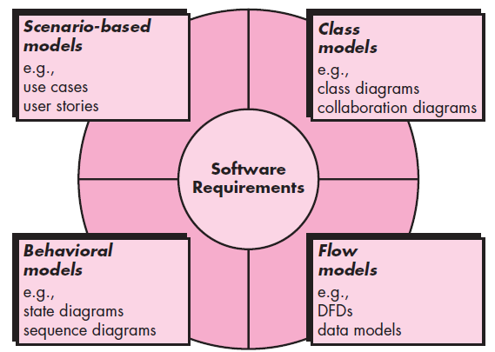
Requirement Modeling Strategies

Slide 4
Elements of UML Behavioral Models
State Diagram
Sequence Diagram

Slide 5
Creating Behavioral Model
The modeling notation that we have discussed to this point represents static elements of the requirements model.
It is now time to make a transition to the dynamic behavior of the system or product.
To accomplish this, you can represent the behavior of the system as a function of specific events and time.

Slide 6
Creating Behavioral Model
The behavioral model indicates how software will respond to external events or stimuli.

Slide 7
Creating Behavioral Model
To create the model, you should perform the following steps:
1. Evaluate all use cases to fully understand the sequence of interaction within the system.
2. Identify events that drive the interaction sequence and understand how these events relate to specific objects.

Slide 8
Creating Behavioral Model
3. Create a sequence for each use case.
4. Build a state diagram for the system.
5. Review the behavioral model to verify accuracy and consistency.

Slide 9
Identifying Events with Use Case
In general, an event occurs whenever the system and an actor exchange information.
An event is not the information that has been exchanged, but rather the fact that information has been exchanged.

Slide 10
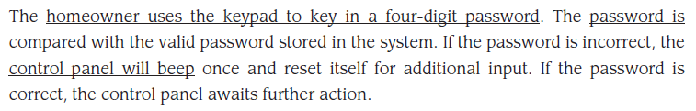
Identifying Events with Use Case

Slide 11
Identifying Events with Use Case
The underlined portions of the use case scenario indicate events.
An actor should be identified for each event; the information that is exchanged should be noted,
And any conditions or constraints should be listed.

Slide 12
State Diagram
One component of a behavioral model is a UML state diagram
That represents active states for each class and the events (triggers) that cause changes between these active states.
Each arrow in STD represents a transition from one active state of an object to another.

Slide 13
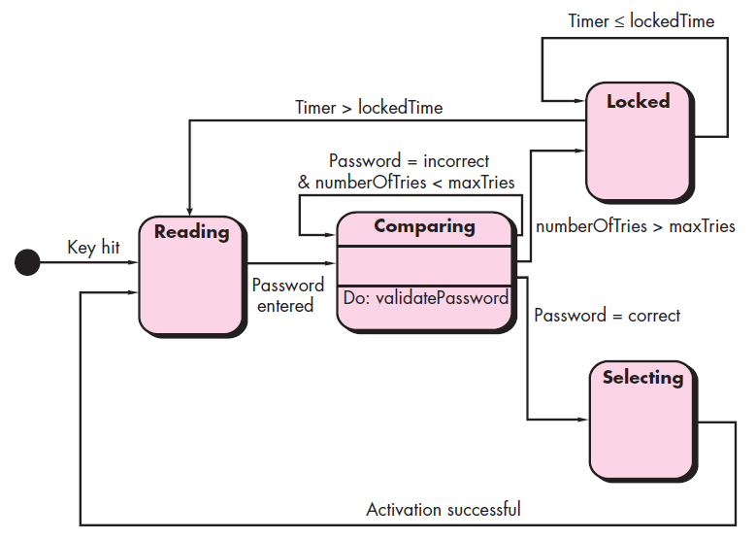
State Diagram – Control Panel

Slide 14
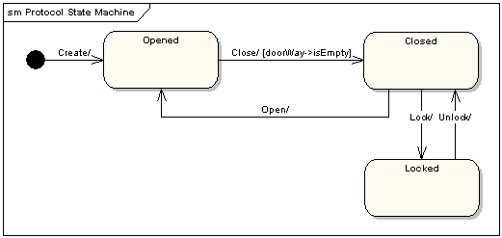
Door

Slide 15
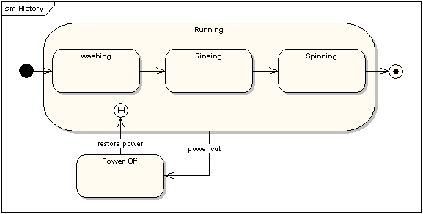
Washing Machine

Slide 16
Sequence Diagram
The second type of behavioral representation, called a sequence diagram in UML, indicates how events cause transitions from object to object.
In essence, the sequence diagram is a short-hand version of the use case.
It represents key classes and the events that cause behavior to flow from class to class.

Slide 17
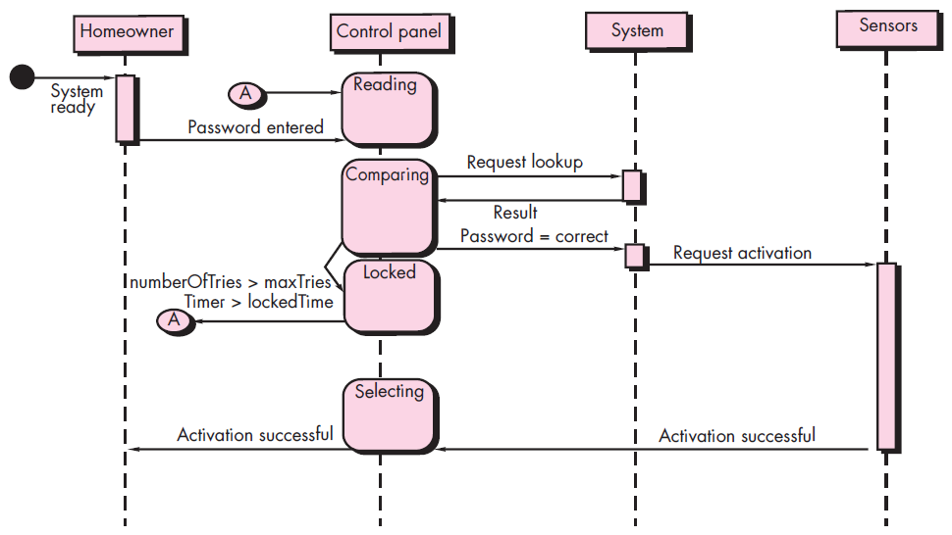
Sequence Diagram – Safe Home Security Function

Slide 18
Sequence Diagram – Safe Home Security Function
Each of the arrow represents an event (derived from a use case) and indicates how the event channels behavior between SafeHome objects.
Time is measured vertically (downward), and the narrow vertical rectangles represent time spent in processing an activity.
States may be shown along a vertical time line.

Slide 19
The End
Thanks for listening
Questions would be appreciated.

